Slide 1
Supervised Deep Learning HEALS EWAS Workshop Meeting
Soütrik Banerjee
Tour Zamansky, Campus Jussieu
18-01-2019

Slide 2
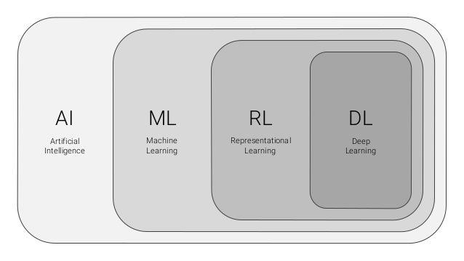
Deep learning lies deep in the realm of Artificial Intelligence

Slide 3
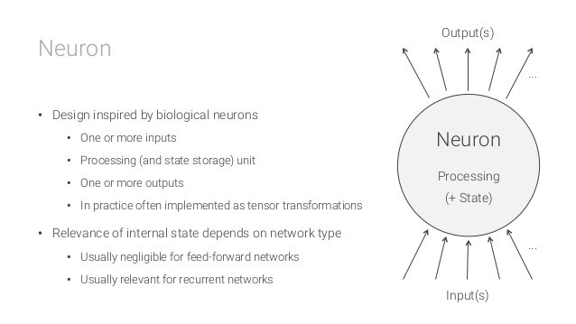
Origins lie in the neural transmission mechanism by synapse activation

Slide 4

Image: recognition, style transfer NLP: speech recognition, text generation, sentiment analysis Stocks, sales, Weather, …: prediction … Virtually every field

Slide 5
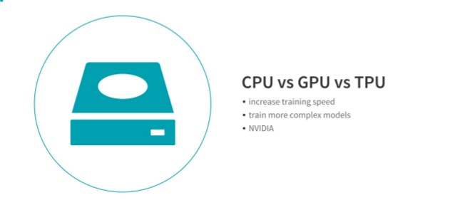
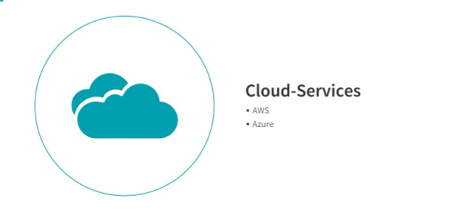
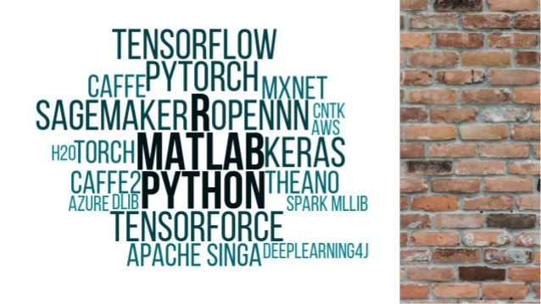
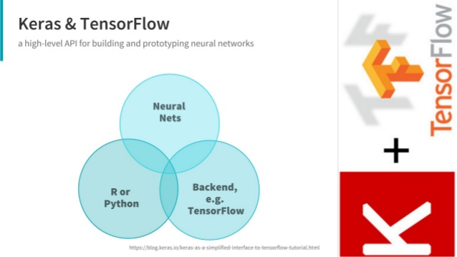

Slide 6
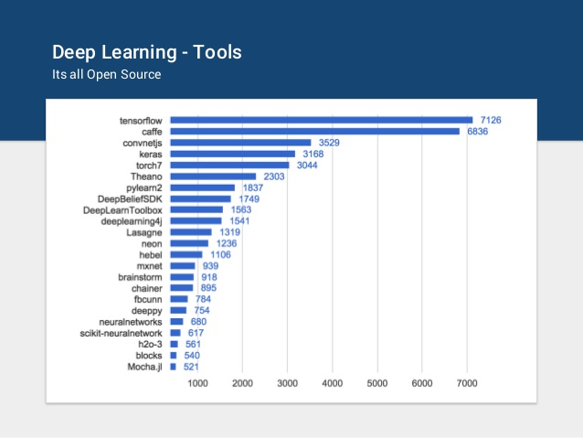

Slide 7


Slide 8
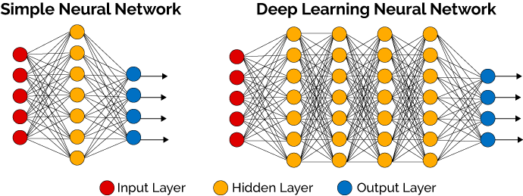
From simple network to multiple layers (deep) simulating the nervous system

Slide 9
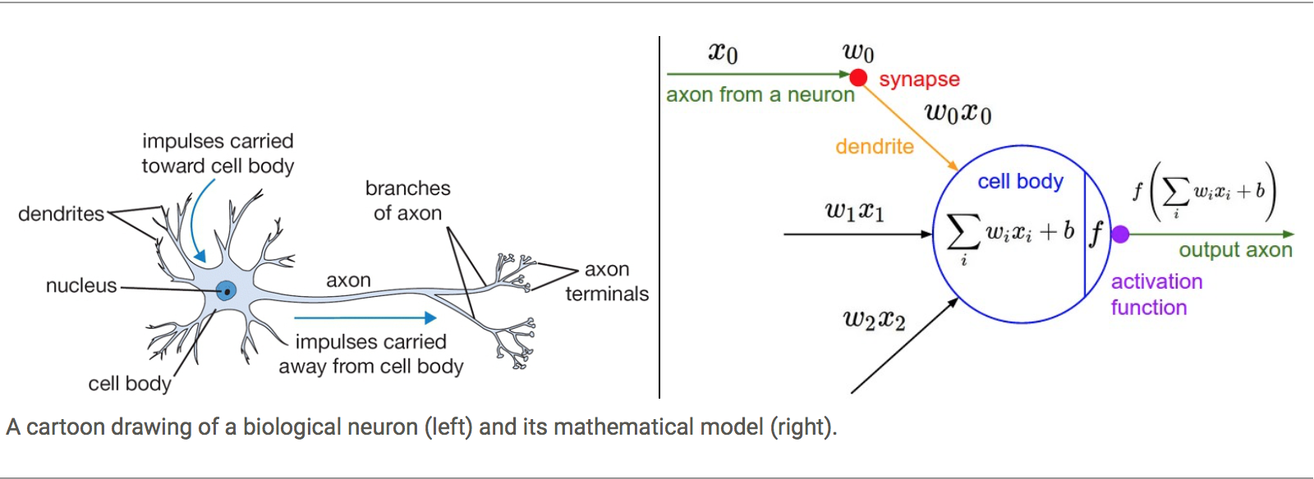
Activation function: (leaky) ReLU, softmax, Tanh, Sigmoid, …

Slide 10
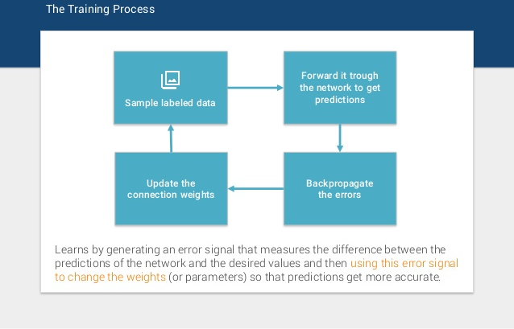
‘Supervised’ Deep Learning essentially

Slide 11
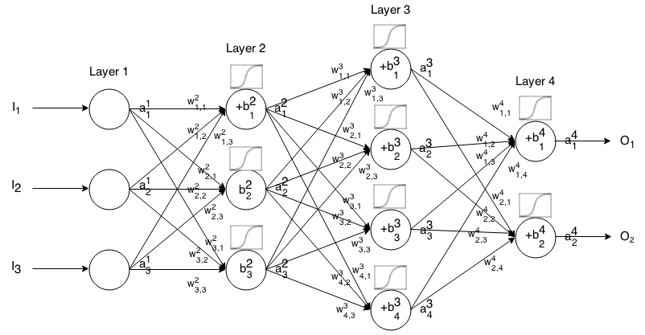
Forward propagation

Slide 12
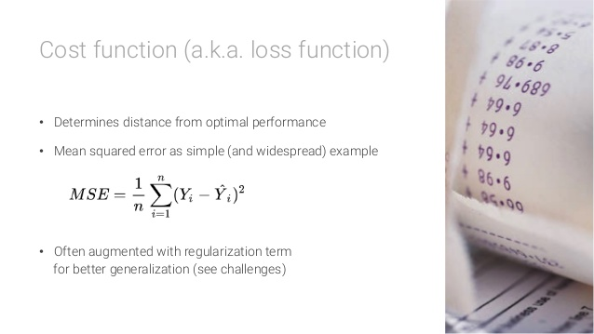

Slide 13
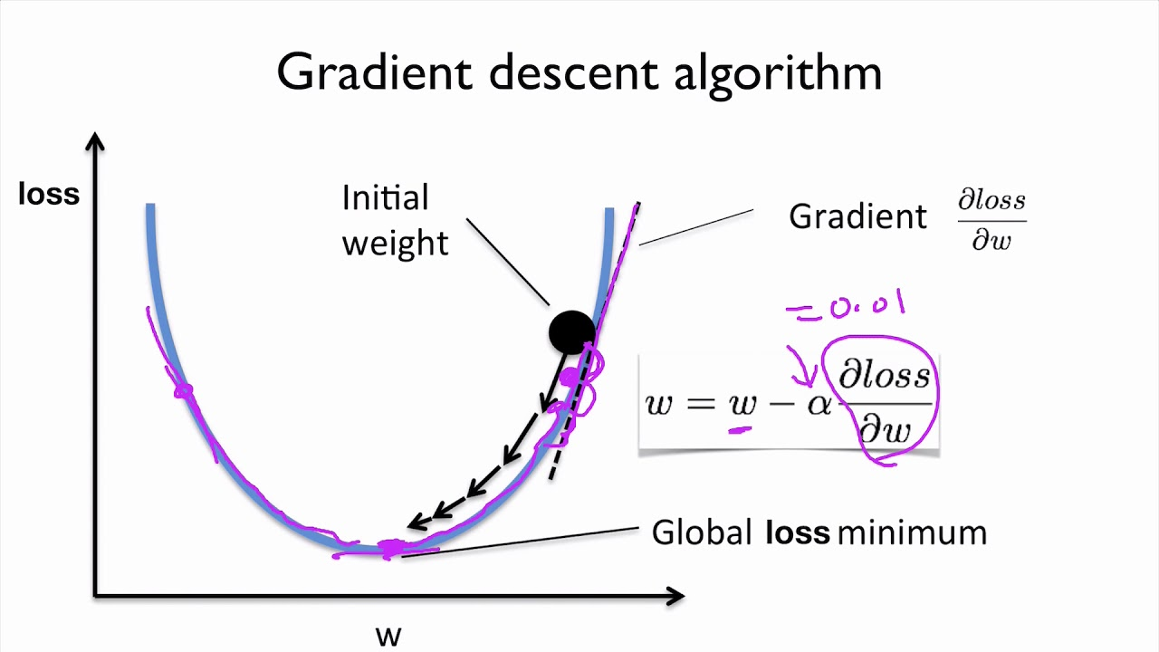
Notes:
alpha = learning rate

Slide 14

Deep Learning steps:
Data: normalise ≠ standardise, split into training, test [& validation] sets
Init: Initialise weights & biases (~ random no.s generated)
Forward propagation + activation functions (e.g., (leaky) ReLU, tanh, sigmoid, softmax)
Cost function (e.g., MSE, RMSE, cross-entropy) ~ calculate tot. Err. (loss fn.)
Back-propagation: by back-propagating the errors to update biases & weights (in mini-batches, for efficiency) ~ “learning from mistakes”
This is so called as (a form of this) error is backpropagated, from the last layer to first, & is used to calculate the partial derivatives of the tot. Err. / loss fn. w.r.t. each Wt.
Once these partial derivatives calculated → gradient descent algo. to minimise train tot. Err., where sigmoid fn. is used for easy derivative calculation: f’(x) = x * (1 - x)
SGD or other algorithms $±$ (optimal) learning rate $±$ (Nesterov’s) momentum
Continue training the network in epochs till overfitting starts

Slide 15
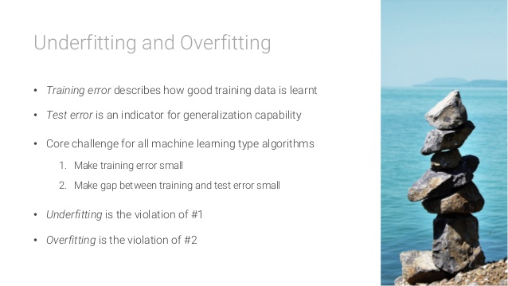

Slide 16
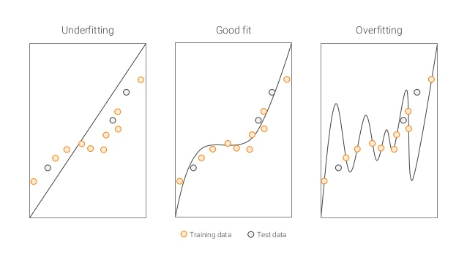

Slide 17

Tuning parameters
Learning rate = small (long training time), large (erratic SGD) ± decay (y/n) ± (Nesterov’s) Momentum
Gradient descent = SGD, Adagrad, Adadelta, …
Activation fn. (feedforward MLP) = (Leaky) ReLU, tanh, sigmoid, softmax, …
Network architecture = RNN, LSTM / GRU, GAN, ConvNet, …
Epochs = no. of max iterations x mini-batch size (8, 16, 32, 64, 128)
Max-pooling, padding (for ConvNet only)
No. of layers (3), no. of nodes ($\sqrt{p}, \frac{1}{2}p$); p = no. of features, structure of network
Regularisation factors (L1 norm, L2 norm)
Dropout (0.3, 0.4, 0.5) or keep (0.7, 0.6, 0.5)
Early stopping (y/n)
Notes:
one epoch = one forward pass and one backward pass of all the training examples
batch size = the number of training examples in one forward / backward pass. The higher the batch size, the more memory space you'll need
number of iterations = number of passes, where each pass using [batch size] number of examples. To be clear, one pass = one forward pass + one backward pass (do not count the forward and backward passes as two different)
Example: if you have 1000 training examples (n), and your batch size is 500, then it will take 2 iterations to complete 1 epoch

